Slide 1
Reconstruction of protein conformations from estimated positions of the Cα coordinates
Philip W. Payne, Protein Science, pp.315-324, 1993.
Presenter : Hsiao-Yen Chang
Date : October 3, 2007

Slide 2
Abstract
Protein Cα coordinates are used to accurately reconstruct
complete protein backbones and side-chain directions. This
work employs potentials of mean force to align semirigid
peptide groups around the axes that connect successive
Cα atoms. The algorithm works well for all residue types
and secondary structure classes and is stable for imprecise
Cα coordinates. Tests on known protein structures show
that root mean square errors in predicted main-chain and
Cα coordinates are usually less than 0.3 Å. These results
are significantly more accurate than can be obtained from
competing approaches, such as modeling of backbone
conformations from structurally homologous fragments.

Slide 3
Input & output
Input:
The protein chain with Cα coordinates.
Output:
The complete protein backbone and side-chain directions (Cβ coordinates).

Slide 4
Materials
The validated database comprised the following 61 Brookhaven entries: 1BP2, ICSE, lCRN, lALC, lCTF, lGCR, lGD1, IGOX, 1GP1, lHMQ, lHOE, 1LZ1, lMBC, IMLT, lPAZ, IPPT, lRDG, ISGT, lTON, IUBQ, 2ACT, 2ALP, 2APP, 2APR, 2AZA, 2CDV, 2CI2, 2CPP, 2FB4, 2HHB, 2LHB, 2LZM, 2MHR, 20V0, 2PRK, 2RHE, 2SGA, 2UTG, 2WRP, 3EBX, 3EST, 3FAB, 3GRS, 3INS, 3RNT, 3RP2,3SGB, 3TLN, 3WGA, 451C, 4FD1, 4FXN, 4PTP, SCHA, SCPA, SCYT, 6PCY, 6PT1, 7RSA, 8DFR, 9PAP.
The dataset contains 9,476 residues.

Slide 5
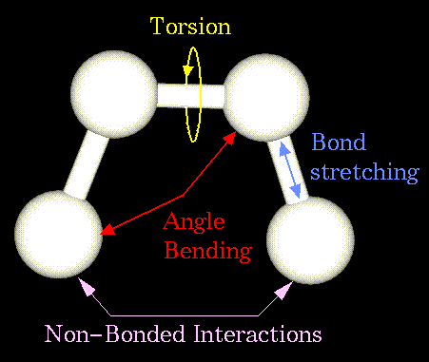
Molecular Mechanics Force-Field
Energy = Stretching Energy + Bending Energy +
Torsion Energy + Non-Bonded Interaction Energy.

Slide 6
Hamiltonian function
The Hamiltonian function of residue k is defined by Equation 2.
h(k) = E[ W_{M}(k), W_{P}(k) ]
+ U[ W_{M}(k), W_{P}(k), Ω(k) ]
+ A{ 1 – cos[ 2π + 2δ(k) ] } (2)
The leading term of Equation 2 is the potential of mean
force (PMF) for non-bonded interactions of two adjacent
peptide planes, the second term is the bond angle
bending energy, and the final term accounts for torsions
about peptide group amide bonds.

Slide 7
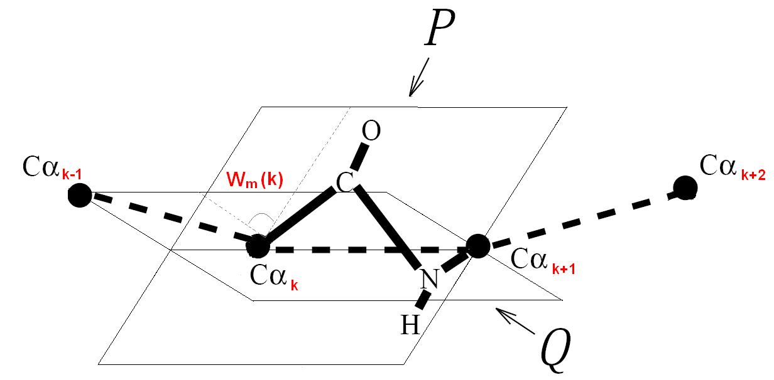
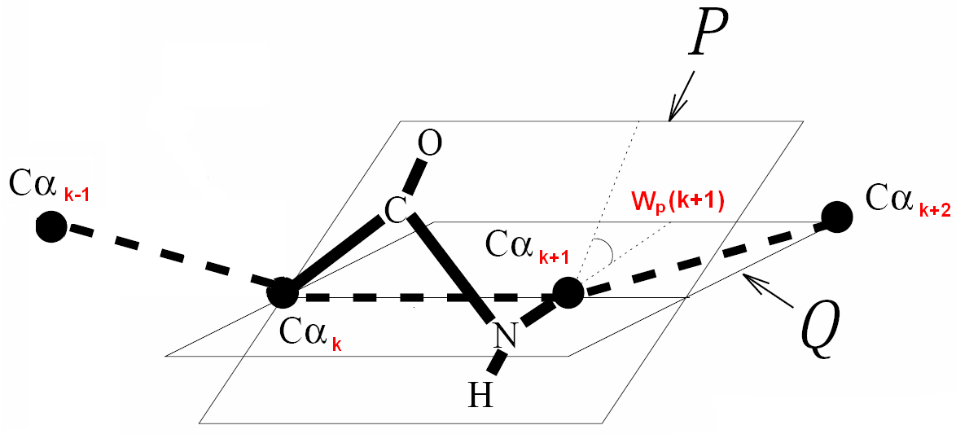
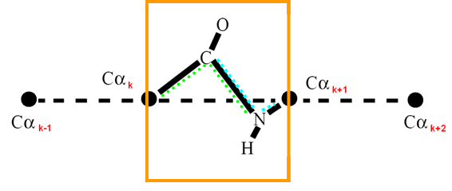
W_{p}(k+1) = W_{m}(k) + π - τ(k, k+1) (1)
τ(k, k+1) is the torsion angle of the Cα chain.

Slide 8
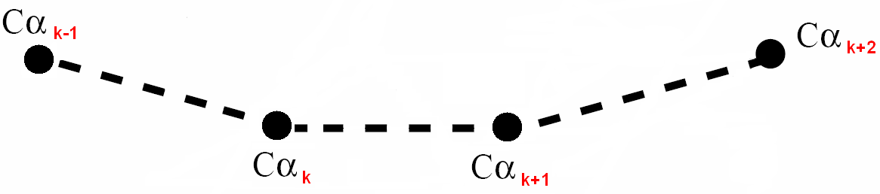
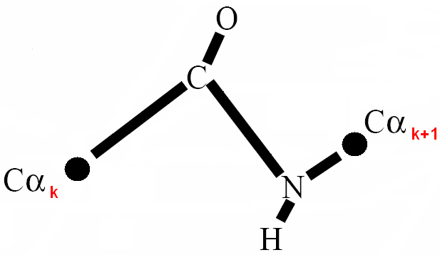
the torsion angle of the Cα chain
τ(k, k+1)
δ(k)
the amide torsion angle
the virtual bond angles of the Cα chain
Ω(k)

Slide 9
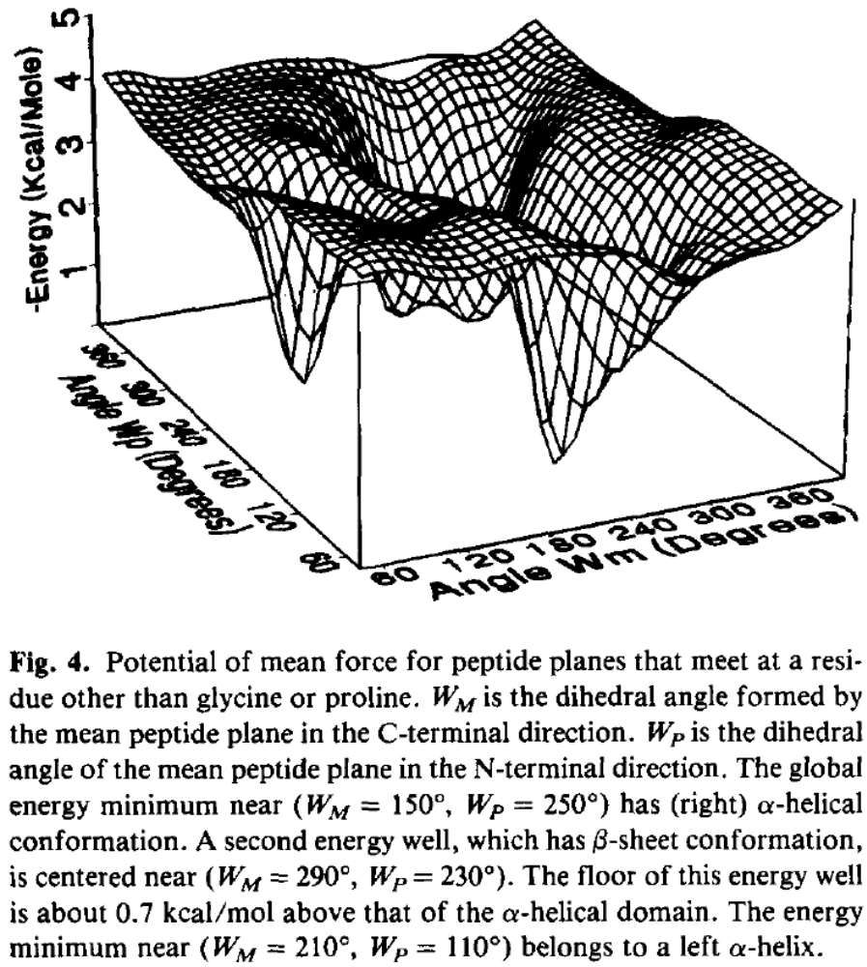
h(k) = E[ W_{M}(k), W_{P}(k) ]
+ U[ W_{M}(k), W_{P}(k), Ω(k) ]
+ A{ 1 – cos[ 2π + 2δ(k) ] }

Slide 10
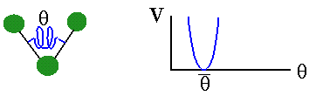
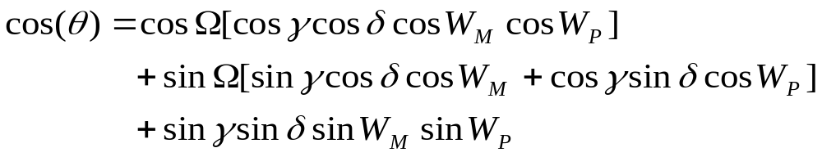

Hamiltonian function (cont.)
The harmonic deformation potential of the N-Cα-C bond angle is
Denote the virtual bond angle Cα(k-1)-Cα(k)-Cα(k+1) by Ω, the N(k)-Cα(k) -Cα(k-1) bond angle by δ,
and the C(k)-Cα(k)-Cα(k+1) bond angle by γ.
(5)
The bond angle bending energy :
(6)
Hooke's law
McLaurin series

Slide 11
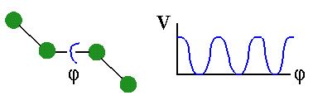
Hamiltonian function (cont.)
Because cosθ is a function of W_{M}, W_{P}, and Ω, the angle strain energy likewise is a function of the latter variables:
U(W_{M}, W_{P}, Ω) ≡V[ θ(W_{M}, W_{P}, Ω) ] (7)
The third term in Equation 2 accounts for torsional puckering of peptide groups about the N-C bond.
E(ω) = A[ 1 - cos(2ω) ] ,ω = π+ δ. (8)
E(δ) = 2A(δ)²
1 - cos(2ω) = 2(sinω)² = 2ω²
h(k) = E[ W_{M}(k), W_{P}(k) ]
+ U[ W_{M}(k), W_{P}(k), Ω(k) ]
+ A{ 1 – cos[ 2π + 2δ(k) ] }

Slide 12
Optimization of the main-chain
Hamiltonian function
The conformation and Hamiltonian function of a protein backbone are defined by four variables per residue: the peptide plane orientation angle W_{M}(k), the internal peptide twist angle δ(k), the virtual bond angle Ω(k), and the Cα chain torsion angle τ(k-1, k).
Because peptide groups interact only through nearest-neighbor potentials, dynamic programming efficiently identifies the global energy minimum of the Hamiltonian function.
This work employed discrete tables of W_{M} and values δ for each residue.

Slide 13
Coordinate generation
Conversion of the peptide plane orientations to atomic coordinates employs standard values for bond angles and bond lengths.
Finally, the Cα-Cβ bond vectors were chosen to yield tetrahedral stereochemistry at Cα.
C
109.5°

Slide 14
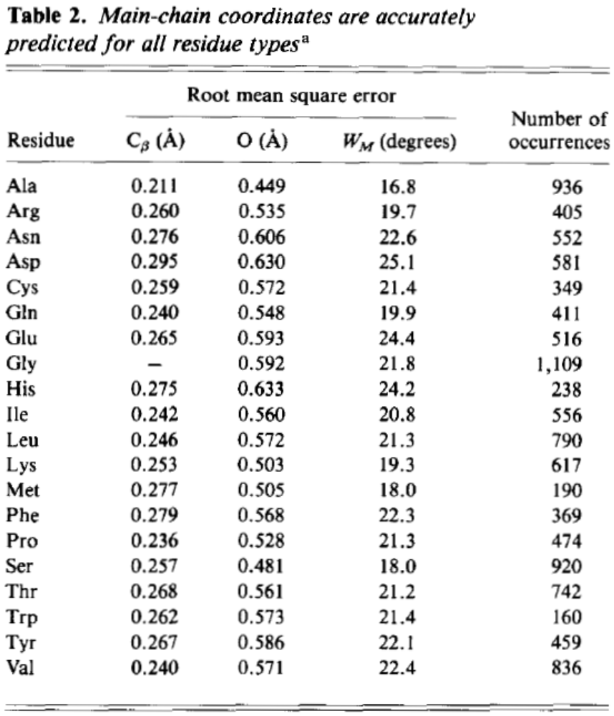
Result

Slide 15
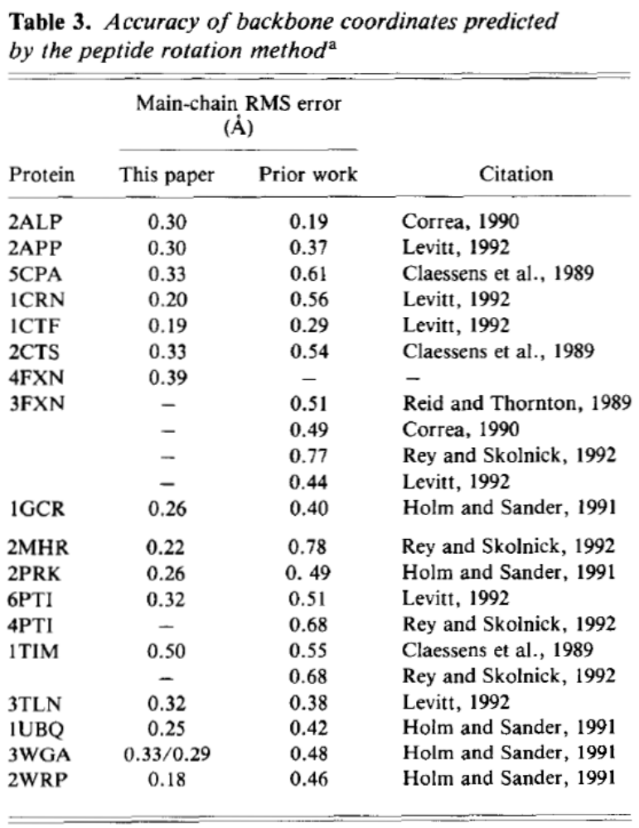
The root mean square (RMS)
error in main-chain coordinates includes deviations of Cα, N, C, and O atoms.

Slide 16
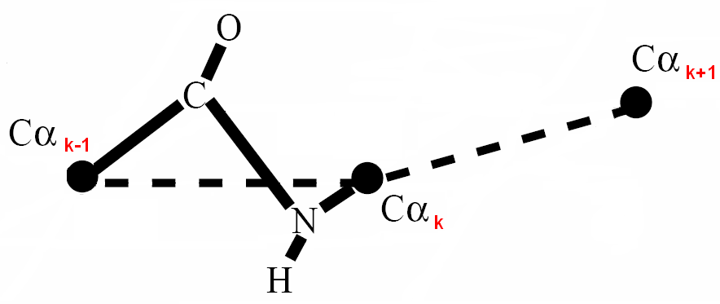
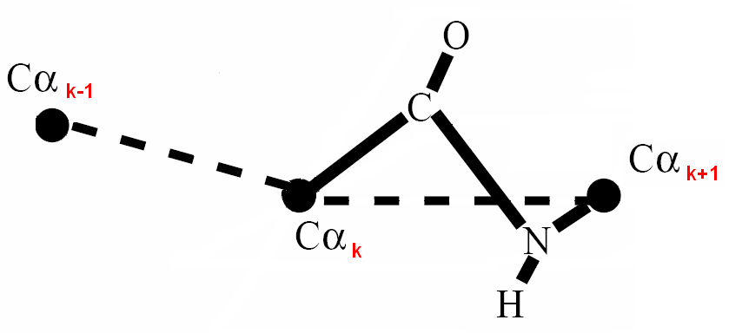
Ω
δ
γ

